Slide 1
Maritime Nuclear Reactors & Fuel
Event 2 – Unbridled Power at Sea: Reactors and Fuels
4 June 2026
Oscar Hamilton, Nuclear Engineer | CORE POWER
Notes:
Good morning. I am Oscar Hamilton, Nuclear Engineer at CORE POWER.
This session is about how reactor technologies and fuel cycles fit together in maritime nuclear.
The main point is that a reactor is not simply a heat source. It is also a safety case, a fuel supply chain, a safeguards case and an operating model.
By the end, I want the audience to understand why reactor and fuel choices have to be made together, not one after the other.

Slide 2
Agenda
01
Introduction
04
Design Trade-Offs & Readiness
02
Nuclear 101
05
Fuel Cycles & Operational Reality
03
Reactor Technologies & Maritime
Notes:
I will start with a short Reactor 101 so that the rest of the session has a common foundation.
Then I will compare the main reactor families that matter for maritime nuclear, from proven light-water reactors through to advanced systems.
After that, I will explain why floating nuclear power plants and propulsion applications do not optimise for the same outcome.
Then I will move into the key design trade-offs, including power density, shielding, passive safety and operational flexibility.
Finally, I will cover fuel cycles and show why fuel choice changes the supply chain, safeguards model, refuelling model and lifecycle plan.

Slide 3
Introduction

Slide 4
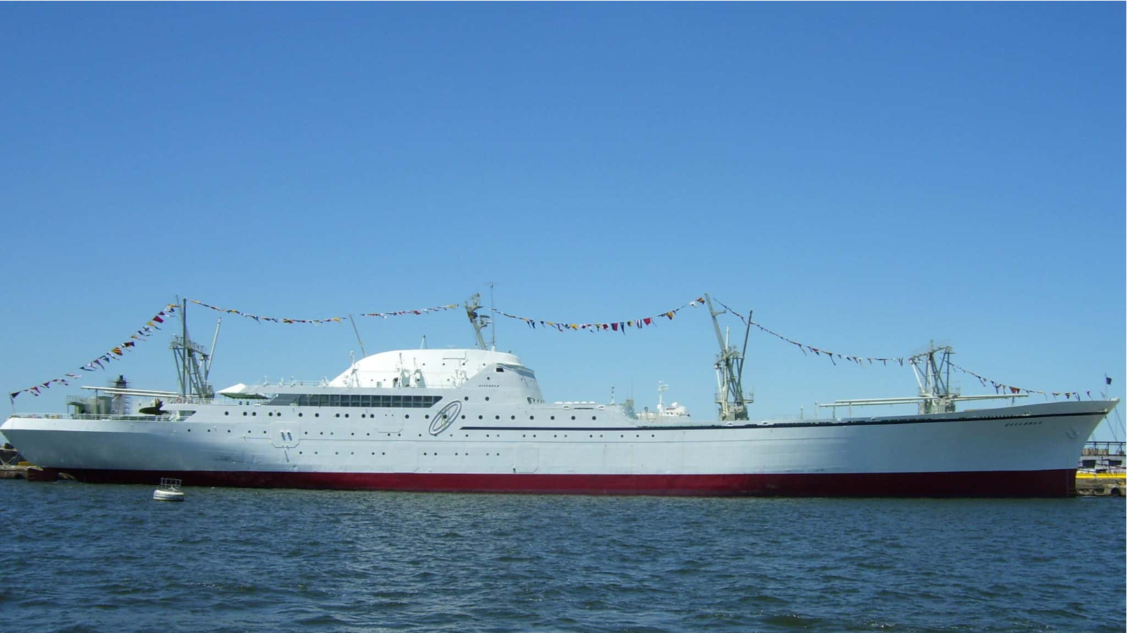
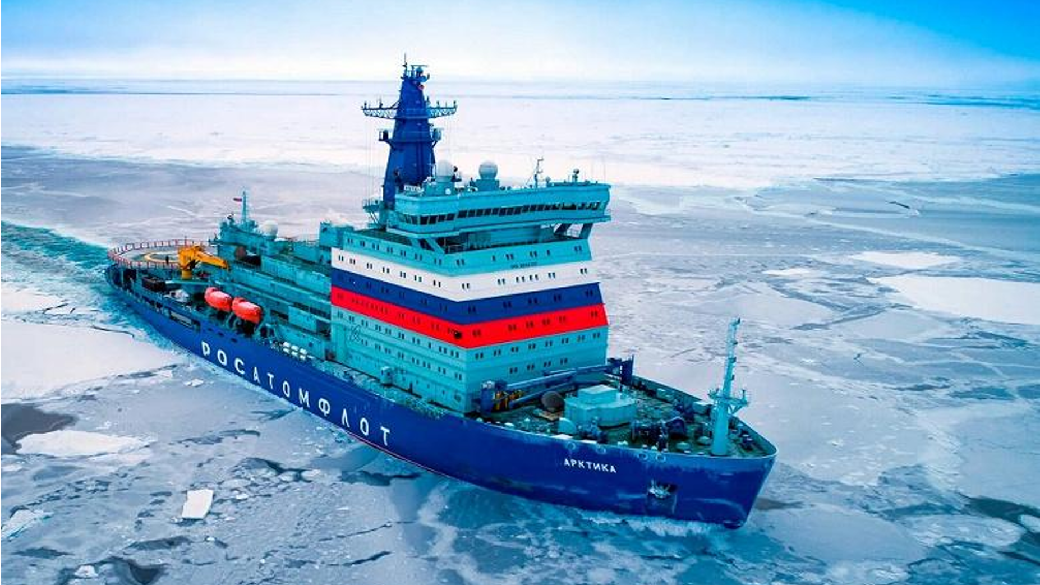
What is our experience with nuclear at sea?
NS SAVANNAH
Since the 1950s, there have been 12,000 reactor years of reactor operations.
  Starting in the 60s USA, Germany and Japan commissioned and operated one nuclear-powered merchant vessel each.
  Today, Russia operates the world’s only fleet of nuclear-powered icebreakers, consisting of five classes of surface vessels.
  Today, Russia also operates the world’s first FNPP, Akademik Lomonosov, supplying electricity and heat to remote Arctic communities and industrial users.
Arktika Nuclear Icebreaker
Notes:
The images on this slide make an important point: nuclear power at sea is not a new idea.
Since the 1950s, naval nuclear propulsion has built up many thousands of reactor-years of operating experience.
The NS Savannah shows that a nuclear-powered merchant vessel was technically possible decades ago, even though the commercial case did not continue into a fleet.
The Arktika icebreaker example shows that nuclear propulsion can provide high endurance and reliable operation in harsh Arctic conditions.
Akademik Lomonosov adds a different model: a floating nuclear power plant that supplies electricity and heat from a marine platform rather than propelling a ship.
The lesson is not that every historical example should be copied. The lesson is that the physics and marine engineering are feasible, while the modern challenge is commercial deployment, licensing, safeguards and public acceptance.

Slide 5

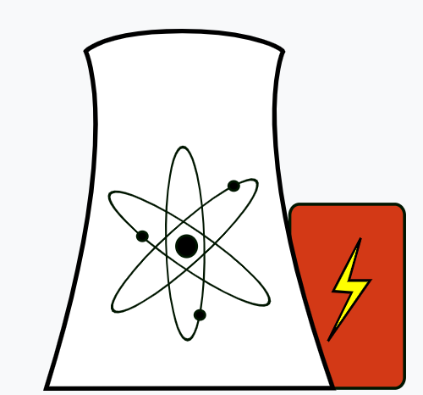
Key criteria for nuclear in commercial maritime
Insurance | Emergency Planning Zone (EPZ) within the vessel boundary.
Safeguards | Strict oversight, material accounting, and surveillance.
Safety | Inherently safe, by physics and chemistry.
Economics | Superior fuel efficiency. Compact size.
Notes:
This table is useful because it shows that commercial maritime nuclear is not judged only on reactor performance.
Insurance depends on having a credible safety case, credible emergency planning and a convincing argument that consequences can be controlled within the marine asset and its operating environment.
Safeguards are central because nuclear material has to be accounted for, protected and monitored through transport, operation, refuelling and end-of-life management.
Safety should be framed as a combination of inherent physics, passive features, engineered barriers, operational controls and emergency arrangements, rather than simply saying the plant is inherently safe.
Economics depend on fuel energy density, capacity factor, plant availability, maintenance model, regulatory burden and the amount of useful ship or platform space lost to the nuclear plant.
So the key question is whether a technology helps with insurance, safeguards, safety and economics at the same time.

Slide 6
Naval Reactors
1950s-present: More than 200 reactors deployed in over 160 ships worldwide, mostly submarines.
They are usually compact PWRs using ordinary water as coolant and moderator, designed for high power density, long core life, and endurance rather than civilian economics.
Key Factor | Why is it a barrier for civilian use?
HEU Fuel | Many naval designs rely on HEU, which brings major security, safeguards, and proliferation concerns.
Different Regulator | Naval reactors in the US are overseen by Naval Reactors / NNPP, not the NRC.
Design Standard | Naval reactors are optimized for best-in-class compactness, shock resistance, stealth, and long life, not low-cost commercial electricity generation.
Notes:
Everybody talks about naval reactors, and it’s true – they are the strongest operating precedent for reactors at sea, but it is not always directly transferable to civilian maritime use.
Naval reactors are generally compact PWR-based systems using ordinary water as coolant and moderator, and they are optimised for endurance, power density and mission performance.
The first barrier in the table is fuel. Many naval programmes have used highly enriched uranium, which brings a very different security, safeguards and proliferation context from commercial nuclear fuel.
The second barrier is regulation. Naval reactors are overseen through defence-specific organisations and are not licensed like civil nuclear power plants.
The third barrier is design standard. A military reactor can be optimised for compactness, stealth, shock resistance and long core life, while a commercial plant has to optimise for licensability, cost, maintainability, insurance and customer acceptance.
The takeaway is that naval experience proves maritime nuclear can work, but civilian deployment needs its own fuel strategy, licensing path and commercial operating model.

Slide 7
02. Nuclear 101
Notes:
This section gives the minimum technical background needed for the rest of the presentation.
The aim is not to go deep into reactor physics, burnup modelling or spent fuel chemistry.
The aim is to make the later discussion of reactor families and fuel choices understandable to a non-specialist audience.
The key idea is that a reactor is a controlled heat source, but the way it produces heat is very different from conventional combustion.
Nuclear fuel is loaded for long operating periods, changes composition during operation, and still requires cooling, shielding and management after it leaves the reactor.
This matters for maritime deployment because fuel behaviour directly affects refuelling frequency, operating availability, safeguards, port-state confidence, waste planning and lifecycle cost.
So, when I introduce burnup, plutonium production and spent fuel composition, I am not trying to give a detailed physics lecture.
I am using those concepts to explain why reactor technology and fuel cycle choices have to be considered together from the start.

Slide 8
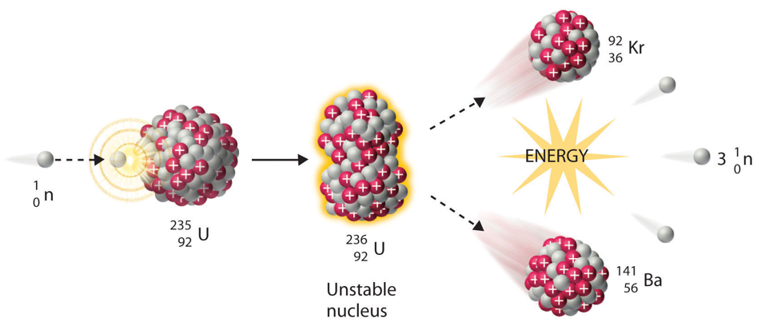
What is the origin of nuclear energy?
In the late 1930s, we discovered that some particularly large atoms found in nature can be split into two (fission) by colliding neutrons, releasing a very large amount of energy as heat – 83 million times larger than combustion.
Fission produces two smaller atoms (fission products) and releases several neutrons. These neutrons can then cause more fission reactions – leading to a self-sustaining chain reaction.
In nuclear reactors these heavy atoms are arranged to create a controlled chain reaction (critical reactor) that generates reliable, carbon-free energy.
Notes:
Nuclear energy comes from fission, which is the splitting of heavy atomic nuclei such as uranium-235.
When a fissile atom absorbs a neutron and splits, it releases heat, fission products and more neutrons.
Those released neutrons can cause further fissions, which creates a chain reaction.
A reactor is a machine that controls that chain reaction so that heat is produced steadily and safely.
The practical output of the reactor is heat, and the rest of the plant is there to move that heat, convert it into useful power and keep radioactive material contained.
For the non-technical audience, the most important idea is that nuclear fuel has an extremely high energy density compared with chemical fuel, which is why it is attractive for long-duration maritime applications.

Slide 9
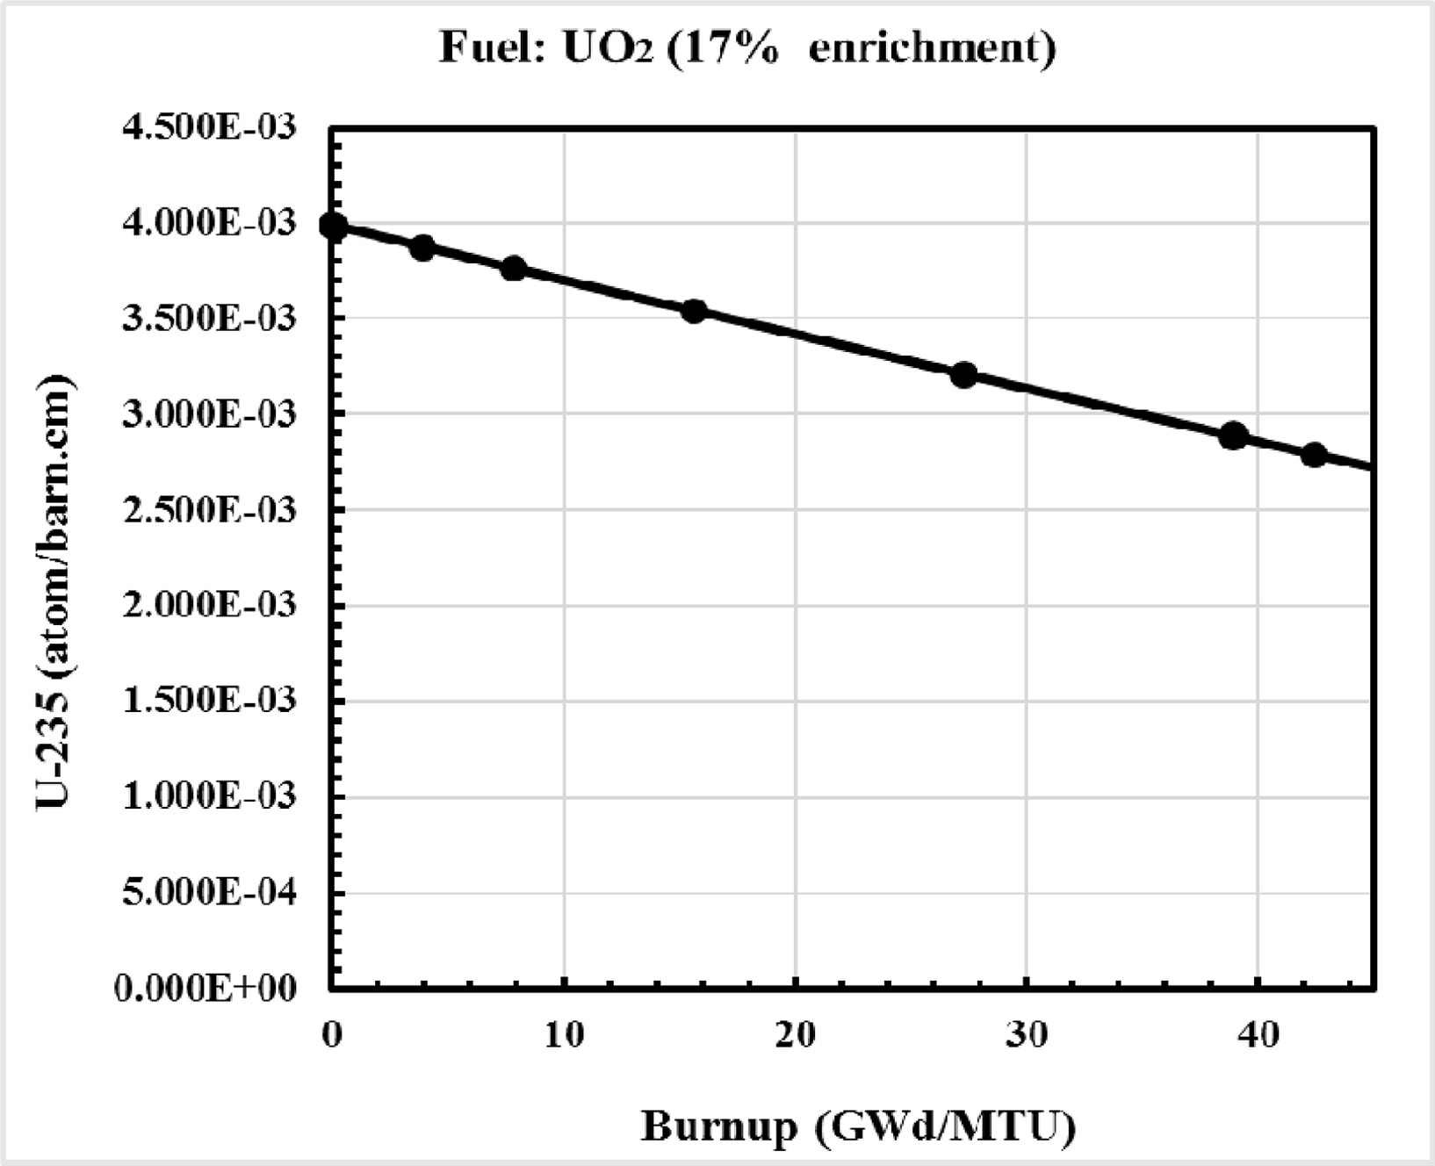
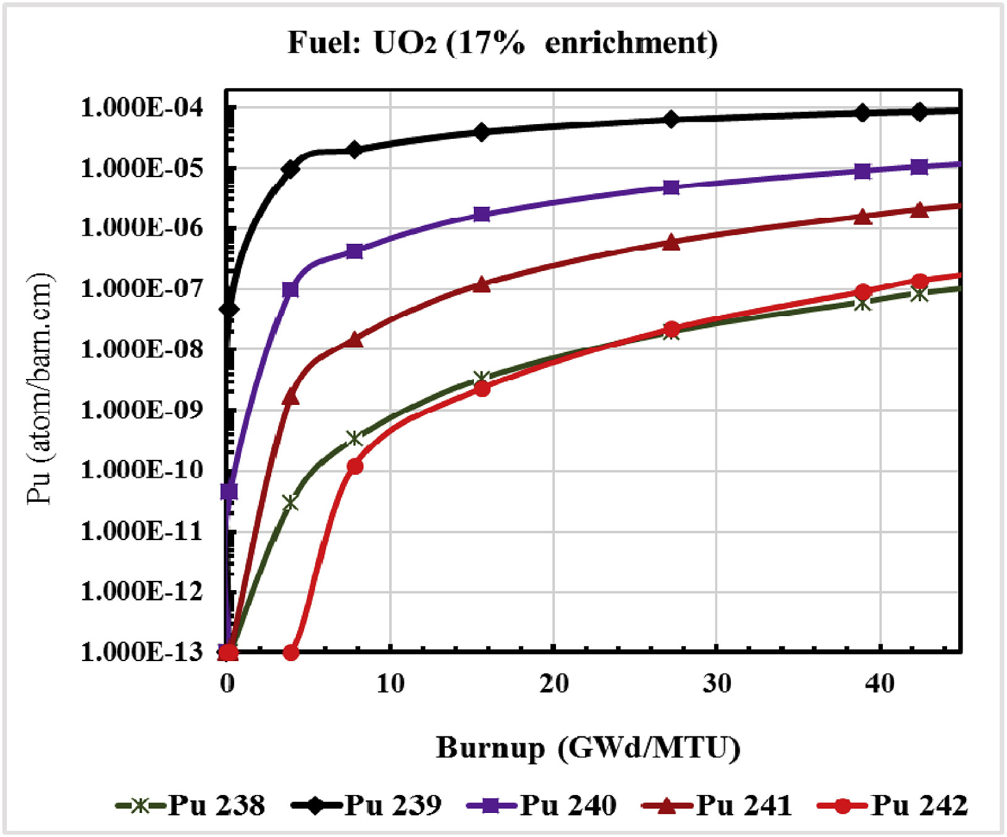
How does a Reactor burn fuel?
The term Burnup is used to quantify how much energy is extracted from nuclear fuel in a reactor. It is measured in energy produced per MT of fuel (GWd/MTU).
Average Burnup depends on reactor design and fuel makeup. Conventional LWRs have an average Burnup of around 40-50 GWd/MTU.
As burnup increases during operation, plutonium bred from U-238 is increasingly consumed through fission. This drives the reactor toward a breed-to-burn balance, where the rate of plutonium production approaches its rate of consumption.
In practice, up to 40% of the energy produced in traditional reactors comes from burning the Pu they generate during operation.
U-235 concertation vs Burnup
Pu concertations vs Burnup
Notes:
The word burnup can be misleading, because nuclear fuel does not burn like oil, gas or coal.
Burnup is a measure of how much energy has been extracted from the fuel, usually expressed as gigawatt-days per metric tonne of uranium.
In a conventional light-water reactor, average burnup is typically around 40 to 50 GWd per tonne of uranium, although the exact value depends on fuel design and operating strategy.
The plots on the slide show that fuel composition changes during operation. U-235 concentration falls as it is consumed, while plutonium is produced from U-238 and some of that plutonium then fissions.
It is reasonable to say that a significant share of the energy in a conventional reactor comes from plutonium produced during irradiation, but I would avoid implying that a normal LWR reaches a true breed-to-burn equilibrium.
The operational point is that burnup determines how long the core can run, when it needs refuelling and what the used fuel will contain at discharge.

Slide 10
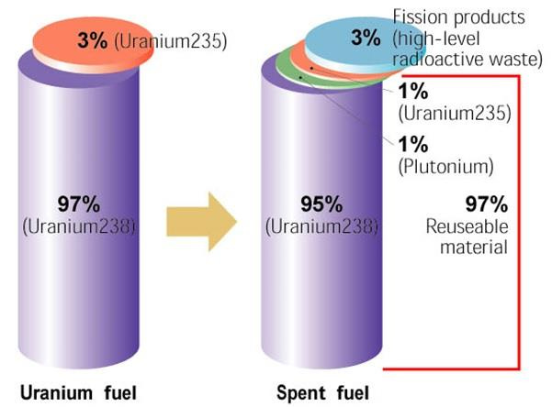
Spent fuel composition
Finally, after a complete fueling cycle, a reactor will only fission ~3-4% of the total fuel. The removed fuel (spent nuclear fuel) still contains about 96% reusable material.
In a conventional cycle, this spent fuel would retain 30% of the initial U-235 and roughly equal amounts of bred Pu from the U-238.
The spent fuel will also contain about half of the periodic table in Fission Products, with some being heavily radioactive. For this reason, nuclear fuel is always cooled (letting FPs decay) prior to disposal or reprocessing.
Conventional LEU Fresh Fuel vs Spent Fuel Composition
Notes:
This slide explains why used fuel is both valuable and demanding to manage.
After a fuel cycle, only a small fraction of the original heavy-metal material has actually fissioned.
The used fuel still contains uranium and plutonium, which means there is potentially reusable material in the fuel.
At the same time, it contains fission products and higher actinides, many of which are radioactive and produce decay heat after shutdown.
That is why spent fuel needs cooling, shielding, accountancy and a regulated storage, recycling or disposal route.
This is the first place where the link between reactor choice and lifecycle management becomes clear, because the reactor determines what comes out of the core.

Slide 11
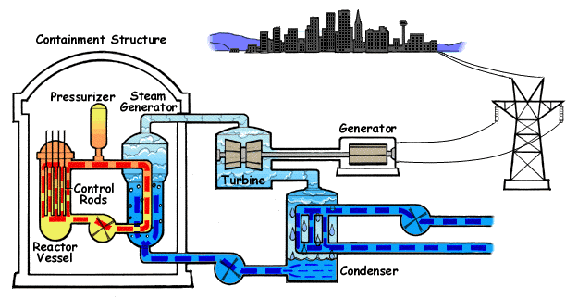
How do nuclear power plants work?
Notes:
Lets move on to how this translates into electrical power that we see everyday when we turn the lights on:
This diagram is the simplest way to think about a nuclear power plant.
The reactor produces heat, and that heat is transferred to a working fluid.
In a conventional steam cycle, heat is used to make steam, the steam turns a turbine and the turbine drives a generator.
The condenser and cooling system then reject unused heat and allow the cycle to continue.
For maritime applications, the useful output may be electricity for a floating power plant, electricity for shipboard systems or mechanical/electric propulsion power.
Different reactor families mainly differ in how they produce heat, move heat and convert heat into useful output.

Slide 12
03. Reactor Technologies & Maritime
Notes:
Let’s now compare the main reactor families that appear in maritime nuclear discussions.

Slide 13
Generation-III / III+ Reactors
1990s-2020s: Limited deployment of Generation-III/III+ reactors.
Spectrum | Moderator | Coolant | Fuel
Thermal | Water | Water | Enriched U
Thermal | Heavy Water | Heavy Water | Nat. or slightly enriched U
  Iterative on Gen-II, with standardized designs, longer design life, lower core damage frequency, better severe accident mitigation, reduced operator action
  This is a result of lessons learned from major accidents, resulting in tighter regulation as well as a need for public confidence.
Notes:
Generation III and III+ reactors are evolutionary designs that build on the experience of earlier commercial reactors.
The table shows that they are mainly thermal-spectrum systems using water or heavy water as moderator and coolant, with enriched uranium or natural to slightly enriched uranium depending on the design.
Their value is maturity: standardised design, known fuel, established operating experience and greater regulatory familiarity.
The safety improvements are responses to operating experience and accident lessons, including better severe accident mitigation and reduced reliance on operator action.
For maritime nuclear, this maturity is valuable because licensing and supply chain risk are major deployment constraints.
The limitation is that these systems can be large, pressurised and tied to conventional refuelling models, which may not be ideal for every vessel or platform.

Slide 14
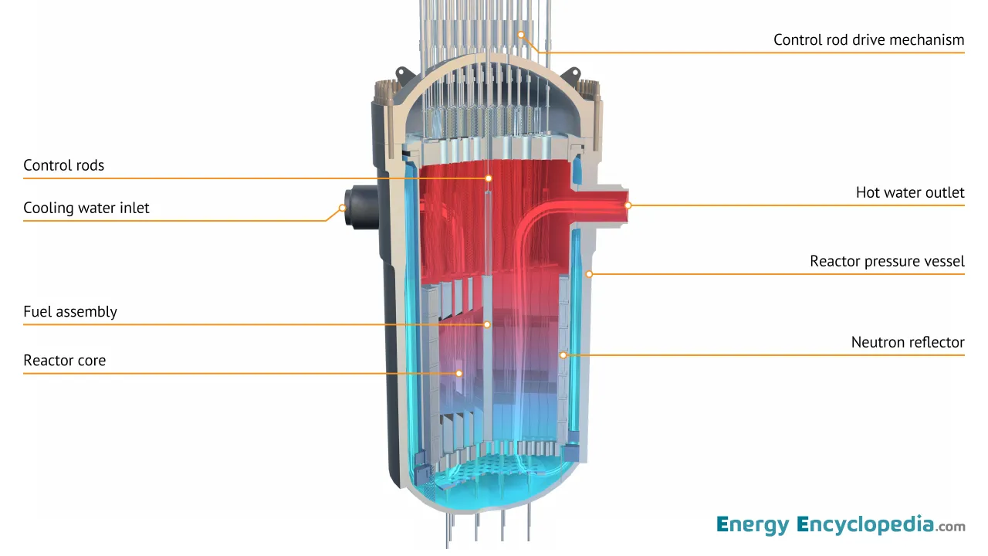
Example 1: Pressurised Water Reactors (PWRs)
This is the most important reference case. It is the dominant global reactor type and the basis for much naval nuclear experience.
Key Characteristics:
  Uses ordinary water as coolant and moderator.
  Primary loop kept under high pressure to prevent boiling.
  Heat is transferred to a secondary loop to make steam.
  Mature supply chain and operating experience.
  Strong regulatory familiarity.
Strongest maritime precedent because naval reactors are predominantly PWR-based, but civilian use faces different economics, licensing, fuel, and operating requirements.
Notes:
The PWR is the most important reference case for this presentation.
It is the dominant commercial reactor type and also the basis for much of the naval nuclear experience base.
A PWR uses ordinary water as both coolant and moderator.
The primary loop is kept at high pressure so that the water remains liquid while removing heat from the core.
Heat is transferred through steam generators into a separate secondary loop, where steam is produced for the turbine.
The advantages are maturity, known fuel fabrication, operating experience and regulatory familiarity.
The maritime penalty is that the plant includes high-pressure systems, heavy components, shielding needs, containment demands and planned refuelling outages.
So PWRs are a strong reference for near-term maritime nuclear, but civilian deployment still has to solve economics, integration, fuel logistics and licensing.

Slide 15
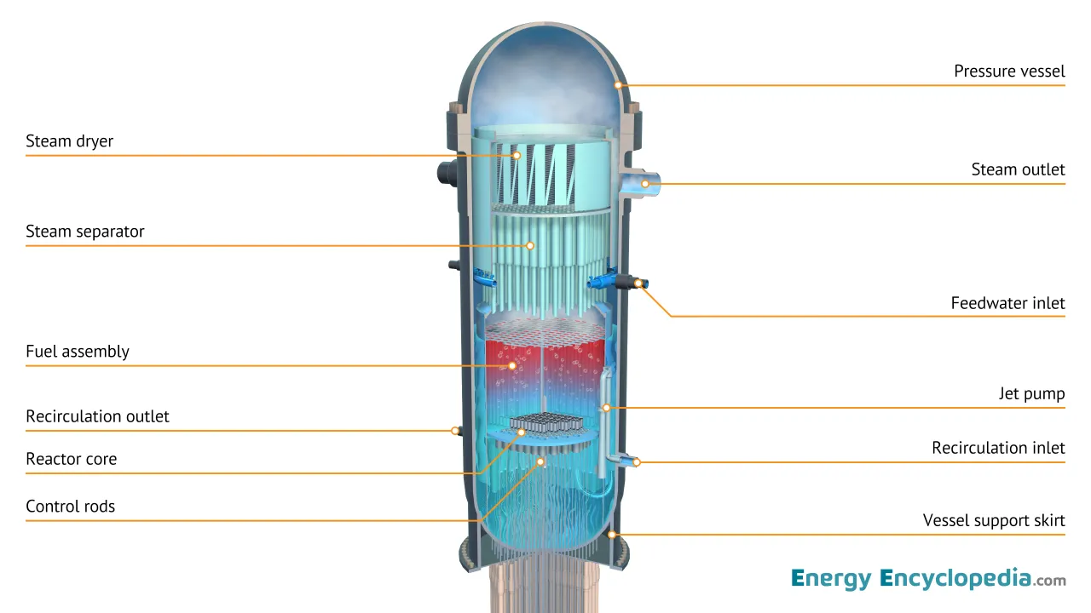
Example 2: Boiling Water Reactors (BWRs)
This is the also a mature Light Water Reactor (LWR), but it has a different plant architecture.
Key Characteristics:
  Uses ordinary water as coolant and moderator.
  Water boils directly in the reactor vessel.
  Steam goes directly to the turbine.
  Simpler steam cycle than PWR in some respects.
  Fewer heat-transfer stages.
Simpler steam cycle than PWRs because steam is produced directly in the reactor vessel, but two-phase flow makes motion effects and marine integration more challenging.
Notes:
A BWR is also a mature light-water reactor, but its plant architecture is different from a PWR.
In a BWR, water boils directly in the reactor vessel and the steam goes directly to the turbine.
That can simplify parts of the steam cycle because there is no separate steam generator.
The trade-off is that the turbine plant is connected to the reactor steam system, which changes the radiological and maintenance boundary.
For marine use, the direct boiling process also creates two-phase flow issues, and two-phase flow can be more sensitive to motion, acceleration and orientation.
This does not mean BWRs are immature. It means their integration case for moving maritime platforms is generally less attractive than the PWR reference case.

Slide 16
Generation-IV Reactors
2000s–future: Development of Generation-IV reactors targeting sustainability, safety, and fuel efficiency beyond Gen-III/III+
Spectrum | Moderator | Coolant | Fuel
Fast/Thermal | None/Graphite/Salt | Sodium/Lead/Gas/Molten Salt | U, Pu, Th
  Shift to non-LWR and fast-spectrum systems, enabling new coolants, higher temperatures, and fundamentally different safety approaches.
  Fuel cycle transformation, with recycling and breeding to maximize resource use and reduce long-lived waste.
  Driven by sustainability, safety, and deployment limits of Gen-III, including stricter post-accident expectations and the need for more economically viable designs
Notes:
Generation IV is not one technology. It is a group of advanced reactor systems with different coolants, neutron spectra and fuel-cycle strategies.
The table shows the key shift away from conventional water-cooled systems toward sodium, lead, gas and molten salt coolants, with thermal or fast neutron spectra depending on the design.
The strategic attraction is that these systems may offer lower pressure, higher temperature, better fuel utilisation and different safety approaches.
For maritime use, low-pressure operation and higher temperature can be valuable because they can affect containment, thermal efficiency and plant architecture.
The fuel-cycle ambition is also different, because some advanced systems are designed to use recycled material, breed fuel or operate with higher burnup.
The caution is maturity. Many Gen IV concepts still face materials, fuel qualification, supply chain and licensing uncertainty before they can be commercial maritime products.

Slide 17
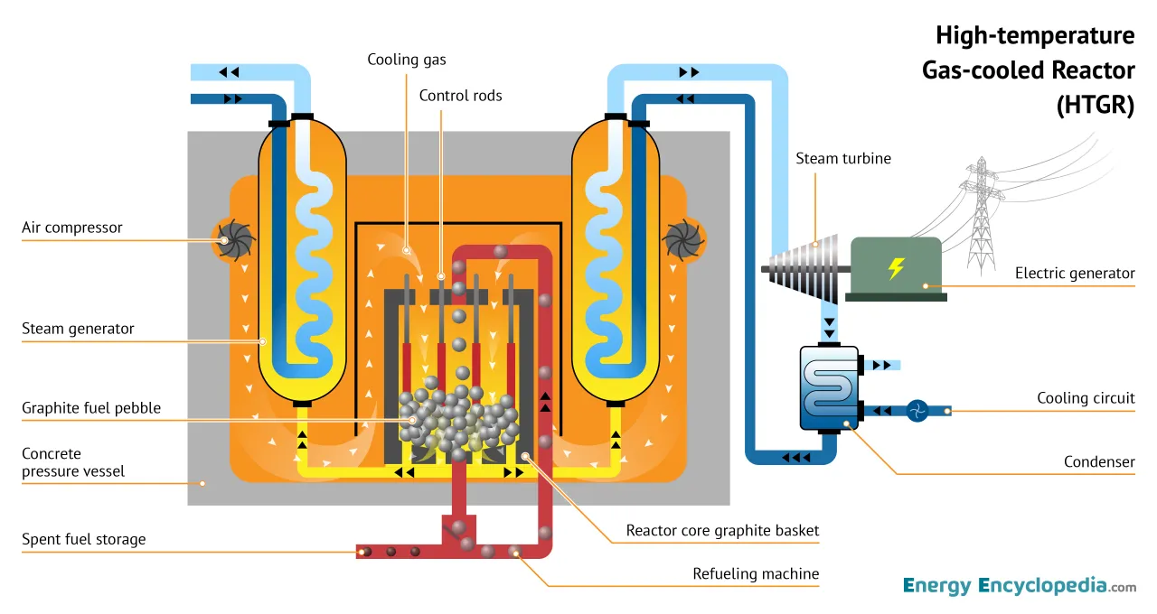
Example 1: High Temperature Gas Reactors (HTGRs)
Key Characteristics:
  Uses helium or other gas coolant.
  Often uses graphite moderator.
  Compatible with TRISO fuel.
  High outlet temperature.
  Strong potential for industrial heat and efficient power conversion.
  Robust fuel form can support safety case.
  HTGRs offer strong fuel robustness and high-temperature capability, but their maritime value depends on whether those benefits outweigh the penalty in plant size and integration complexity.
Notes:
HTGRs normally use helium as coolant, graphite as moderator and TRISO fuel as the fuel form.
Helium is chemically inert and can operate at high temperature, which supports higher thermal efficiency and industrial heat applications.
Graphite moderation and the core geometry usually mean the plant is not as compact as the highest power-density propulsion options.
TRISO fuel is important because each fuel particle contains multiple engineered coating layers that help retain fission products at the particle level.
That fuel robustness can support a strong safety case, especially for high-temperature accident tolerance.
For maritime use, the question is whether the high-temperature benefit and fuel robustness outweigh the penalties in plant volume, shielding layout, helium systems and integration complexity.
HTGRs may be more naturally suited to floating power or industrial heat than to compact high-power propulsion, unless the design case is very strong.

Slide 18
Example 2: Fast Reactors
Sodium Fast Reactor
Lead Fast Reactor
Molten Salt Fast Reactor
Uses liquid metal coolant to remove heat from a compact fast-spectrum core
Liquid sodium coolant.
Fast neutron spectrum.
Low-pressure operation.
Excellent heat transfer.
High power-density core.
Key challenge: sodium reacts with air and water.
Uses dense liquid metal coolant with a very high boiling point
Liquid lead or lead-bismuth coolant.
Fast neutron spectrum.
Very high boiling point.
Chemically less reactive than sodium.
Can support compact cores and long cycles.
Key challenge: heavy coolant and materials corrosion.
Uses molten salt to combine high-temperature operation with a fast neutron spectrum
Molten salt coolant, often with liquid fuel.
Fast neutron spectrum.
Potential for flexible or online refueling.
Strong fuel utilization potential.
Key challenge: salt chemistry, materials, and licensing maturity.
Notes:
Fast reactors do not use a moderator to slow neutrons down, so they operate with a fast neutron spectrum.
That can improve fuel utilisation and can support compact cores, but the coolant and fuel choices become central to the safety and licensing case.
Sodium fast reactors have excellent heat-transfer characteristics, low-pressure operation and potential for high power density.
The main sodium challenge is chemical reactivity with air and water, which matters strongly in a maritime environment where seawater and humidity are unavoidable design considerations.
Lead or lead-bismuth fast reactors use a dense coolant with a very high boiling point and lower chemical reactivity than sodium.
The lead-cooled penalty is weight, corrosion, coolant chemistry control and materials qualification over long operating periods.
Molten salt fast reactors combine high temperature operation with salt coolant and may use liquid fuel, depending on the design.
The attraction is low pressure, fuel flexibility and possible online fuel management, but the uncertainty is salt chemistry, corrosion, off-gas handling, tritium, safeguards and licensing.
The maritime takeaway is that fast reactors may be highly attractive for long-cycle compact propulsion in the future, but their commercial readiness is much lower than PWR-based systems today.

Slide 19
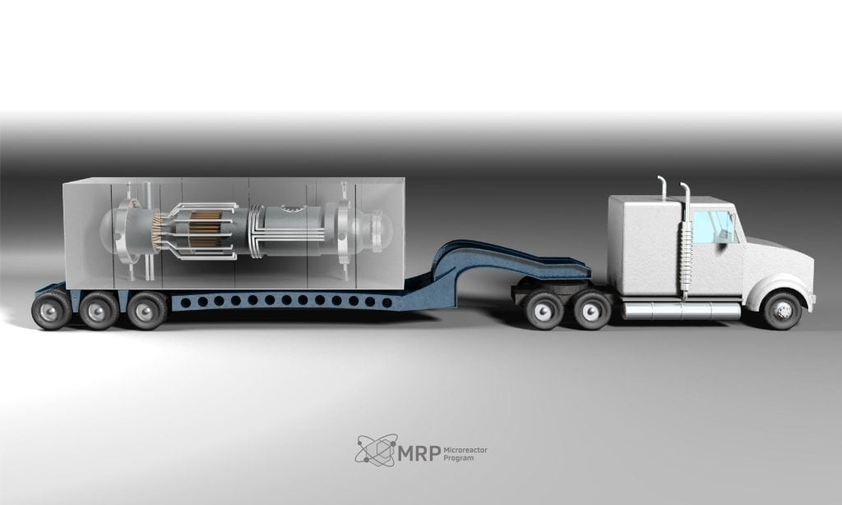
Example 3: Microreactors
Key Characteristics:
  Very small nuclear systems.
  Factory fabrication potential.
  Simplified operation and modular deployment.
  Lower total power output than commercial maritime propulsion or large FNPP needs.
  Could be relevant for ports, islands, offshore assets, or modular floating power.
Microreactors are attractive at sea because they reduce unit scale and support modular deployment, but their low power output means multiple units may be needed, increasing complexity.
Notes:
Microreactors are very small nuclear systems, typically well below the scale of a large commercial propulsion plant or a large floating power plant.
Their value is not that one microreactor replaces a large propulsion reactor.
Their value is modular deployment, factory fabrication, transportability and simplified operation for smaller loads.
In maritime use, they could be relevant for ports, islands, offshore assets, remote sites, small floating power modules or resilient backup power.
The limitation is power output. If the application needs tens or hundreds of megawatts, multiple units may be needed.
Multiple units can improve redundancy, but they also add integration, maintenance, licensing interfaces and fuel-management complexity.

Slide 20
FNPP & Propulsion Optimize for Different Outcomes
Factor | FNPP | Propulsion
Main job | Stable electricity, heat, desalination or industrial power | Move the ship reliably and flexibly
Location | Moored or semi-stationary | Moving asset
Design priority | Availability, maintainability, site integration | Power density, compactness, dynamic response
Motion challenge | Lower, but still marine environment | Continuous ship motion and vibration
Shielding challenge | Can use more mass and separation | Must fit near crew, cargo and machinery
Refuelling model | Planned berth, modular replacement or campaign refuelling | Long endurance, minimal operational disruption
Commercial risk | Power purchase, port state, local grid, liability | Vessel owner, route approval, port access, charter economics
Notes:
This slide explains why the same reactor is not automatically right for every maritime application.
A floating nuclear power plant is mainly selling stable electricity, heat, desalination or industrial power from a moored or semi-stationary platform.
That means the design priority is availability, maintainability, site integration, local grid connection and a credible power-offtake model.
A propulsion reactor is different because the reactor is part of a moving asset whose purpose is to move the ship reliably and flexibly.
For propulsion, power density, compactness, dynamic response, shielding close to crew and compatibility with ship motion become more dominant.
The shielding row is especially important. An FNPP can often use more mass, spacing and platform layout to manage dose, while a ship must fit shielding around cargo, crew spaces and machinery.
The refuelling row also matters. An FNPP can plan campaign refuelling or module replacement at a defined site, while a propulsion application wants long endurance with minimal disruption to the vessel schedule.
The commercial risk is also different. FNPP risk sits around power purchase, site approval, port state, local grid and liability, while propulsion risk sits around vessel owner economics, route approval, port access and charter value.

Slide 21
Generation-III / III+& IV Reactors at Sea
Factor | Gen III / III+ | Gen IV
Technology maturity | High | Low
Regulatory familiarity | High | Low
Fuel supply | Mature | Immature
Operating experience | High | Low
Temperature tolerance | Moderate | High
Pressure | Often high | Often low
Power density | Moderate | Often high
Maritime fit? | Strong near-term FNPP case | Strong long-term potential (propulsion)
Reactor generation is a maturity lens, not a ranking
Gen III / III+
  Strengths at sea: Proven operating model, familiar fuel, established safety case, clearer licensing route.
  Main maritime limitation: Plant size, high-pressure systems, refueling outages, and shielding or containment demands.
Gen IV
  Strengths at sea: Lower pressure, higher temperature, high power density, longer cycles, and improved fuel use.
  Main maritime limitation: Lower operating experience, less mature fuel supply, and more licensing uncertainty.
Notes:
This slide makes a very important point: generation is a maturity lens, not a ranking.
Gen III and III+ systems are not automatically the best technology for every maritime application, but they are the most mature starting point.
Their advantages are proven operating models, familiar fuel, established safety cases, operating experience and clearer licensing pathways.
Their disadvantages at sea are plant size, high-pressure systems, refuelling outages and shielding or containment demands.
Gen IV systems may offer features that are attractive for maritime use, such as lower pressure, higher temperature, higher power density, longer cycles and improved fuel use.
The limitation is that many Gen IV systems have lower operating experience, less mature supply chains and more licensing uncertainty.
The practical interpretation is that Gen III / III+ may fit near-term FNPP deployment more naturally, while some Gen IV systems may become stronger long-term candidates for propulsion if the maturity gaps close.

Slide 22
04. Design Trade-Offs & Readiness
Notes:
This section is about why a reactor that works on land cannot simply be placed on a vessel without changing the design basis.

Slide 23
Nuclear Safety Principles
All commercial nuclear power plants today are designed to meet the following fundamental safety functions, both during operation and accident conditions.
Reactivity Control
Cooling and Decay Heat Removal
Containment of Radioactive Material
Notes:
All reactor safety cases ultimately have to preserve three fundamental safety functions.
First, the plant must control reactivity, meaning it must be able to shut down and remain subcritical when required.
Second, it must remove heat, including decay heat after shutdown, because heat production does not fall to zero immediately.
Third, it must contain radioactive material through fuel, coolant boundary, containment or other barriers depending on the technology.
These functions apply during normal operation, shutdown, maintenance, refuelling and accident conditions.
Different reactor types achieve these functions in different ways, so the safety case has to match the reactor physics, coolant, fuel form and marine environment.

Slide 24
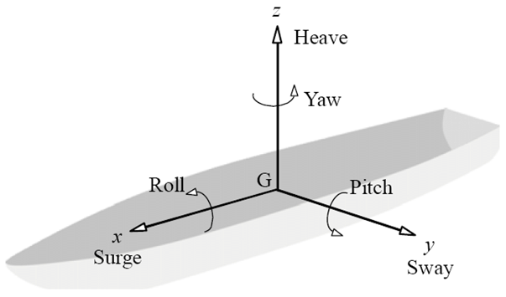
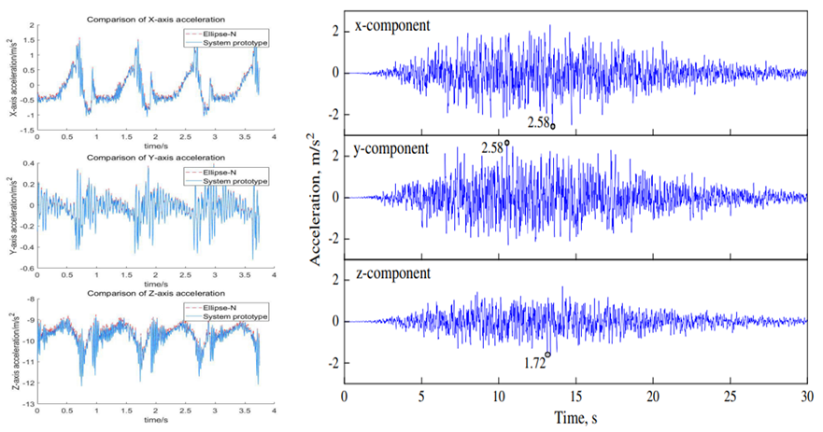
Maritime Unique Operational Conditions
Ship Motions
During normal operation, the marine plant experiences motions with three translational (surge, sway and heave) and three rotational (roll, pitch and yaw) degrees of freedom.
These external accelerations differ substantially from the design basis of land-based reactors.
The plant also experiences vibrations created by rotating machinery that are transferred through the vessel hull.
Marine Acceleration Profile (left) vs to Seismic Acceleration Profile (right)
Notes:
Ships & FNPPs experience unique operational conditions that are not seen on land.
A ship or floating platform moves in six degrees of freedom: surge, sway, heave, roll, pitch and yaw.
The acceleration plots are useful because they show that marine acceleration histories look different from a seismic acceleration profile.
A seismic event is normally treated as a transient external event, while marine motion can be continuous, cyclic and coupled to normal operation.
That matters for pumps, tanks, control rods, heat exchangers, natural circulation paths, instrumentation, fuel handling and maintenance access.
It also matters for reactor selection. Systems that rely on gravity, liquid levels, natural circulation or two-phase flow must be demonstrated under the relevant motion and orientation envelope.
So maritime readiness is not just about compactness. It is about proving that the plant still behaves correctly when the platform moves.

Slide 25
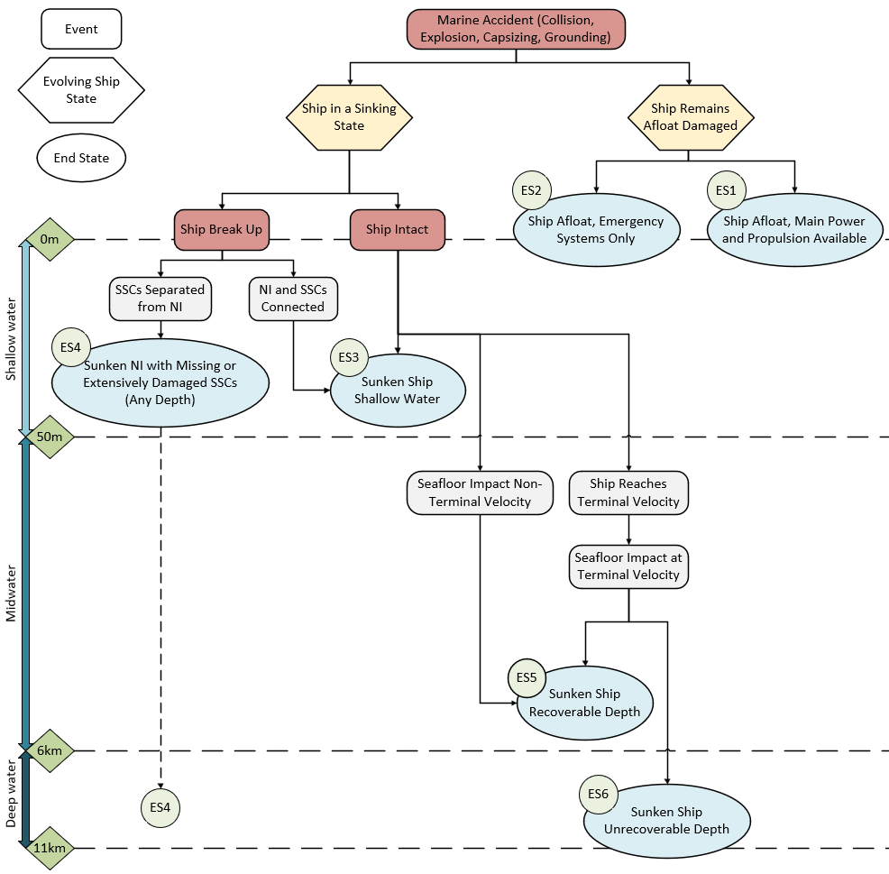
Maritime Unique Accident Conditions
Following maritime initiating events such as collision and grounding, there are six different possible end states for the nuclear plant, unique to the maritime environment
The fundamental safety functions of
  Reactivity Control,
  Cooling & Decay Heat Removal,
  Containment,
  must be ensured indefinitely for these end states
Notes:
This slide extends the safety case from normal marine motion to marine accident end states.
The initiating events include collision, explosion, capsizing and grounding, which are very different from the normal land-based accident framing.
The diagram separates the event, the evolving ship state and the final end state for the nuclear plant.
Some end states keep the ship afloat with main power available or with main power lost.
Other end states include shallow-water sinking, sinking at recoverable depth, sinking at unrecoverable depth or severe damage where safety-related structures, systems and components may be separated from the nuclear island.
For each of those end states, the plant still has to maintain reactivity control, decay heat removal and containment of radioactive material.
The word indefinitely is important because recovery after a marine accident may be delayed by weather, depth, access, salvage constraints and port-state arrangements.
This is why maritime nuclear safety has to be designed from the beginning, not treated as a naval architecture add-on.

Slide 26
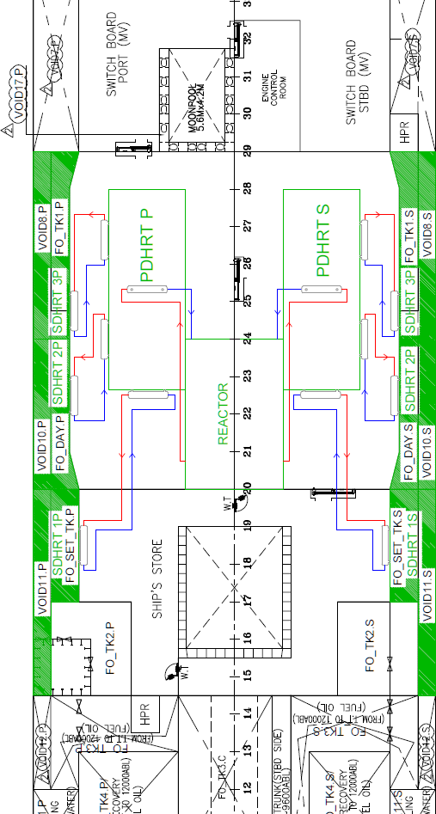
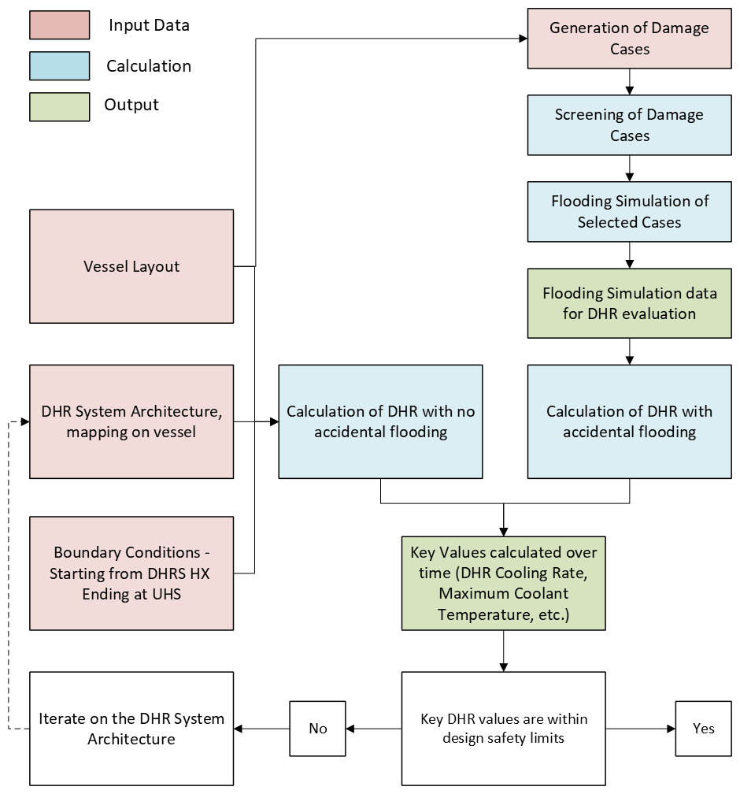
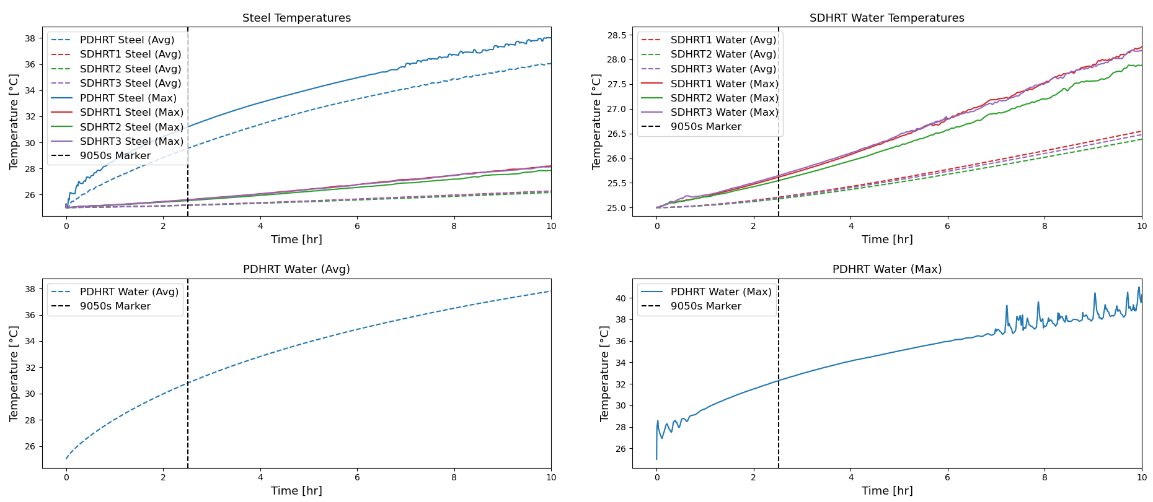
Example: Decay Heat Removal during Flooding Scenarios
Marine accidents can include prolonged or permanent rotation of the plant, impacting the operation of natural circulation systems.
A methodology to evaluate DHR systems during flooding scenarios was developed and published by CP, demonstrated with a generic LWR DHR system.
The study looked at utilizing ship ballast tanks to passively sink decay heat into during accident scenarios.
DHR during Flooding Research, Kourasis I., Vilarino R., Hamilton O., et.al.
Offshore Techology Conference Proceedings 2025
Notes:
This slide gives a concrete example of a marine-specific safety problem.
After shutdown, fission stops, but decay heat remains and must be removed from the core.
In a marine flooding scenario, the plant may experience prolonged heel, permanent rotation, flooding or changed heat-sink access.
Those conditions can affect natural circulation, which is why marine-specific analysis is needed rather than simply assuming a land-based system behaves the same way.
The CORE POWER work referenced here developed a methodology for evaluating decay heat removal under flooding scenarios using a generic LWR system.
The study also looked at the possibility of using ship ballast tanks as passive heat sinks in accident conditions.
The broader point is that passive safety is very valuable, but passive systems still have to be validated for the actual marine orientation, flooding and heat-sink conditions.

Slide 27
Maritime reactor design is a trade-off problem
Design choice | Benefit | Maritime penalty
Higher power density | Smaller core and plant | More shielding demand
More shielding | Lower dose and easier acceptance | More mass and less usable vessel space
Higher thermal efficiency | More useful power per MWth | Higher temperatures, materials demands and integration complexity
Passive safety | Lower reliance on active systems | May need larger structures or specific orientations
Long refuelling cycle | Higher availability | Higher initial fissile loading, safeguards and supply chain burden
Low pressure coolant | Lower pressure accident challenge | New chemistry, materials or licensing uncertainty
Notes:
This table is one of the clearest strategy slides in the deck because it shows that every design benefit has a maritime penalty.
Higher power density can reduce core and plant size, but it can also increase shielding demand and tighten thermal margins.
More shielding reduces dose and helps acceptance, but it adds mass and takes away valuable vessel or platform space.
Higher thermal efficiency gives more useful power per megawatt thermal, but it usually means higher temperatures, tougher materials demands and more complex integration.
Passive safety can reduce reliance on active systems, power supplies and operator action, but passive heat-removal paths may need space, height, orientation or large structures.
A long refuelling cycle improves availability, but it normally requires higher initial fissile loading, which affects safeguards, fuel procurement and regulatory scrutiny.
Low-pressure coolants can reduce pressure-driven accident concerns, but they may introduce new chemistry, materials, coolant handling and licensing uncertainty.

Slide 28
05. Fuel Cycles & Operational Reality
Notes:
This is where the reactor discussion becomes a commercial deployment discussion.

Slide 29
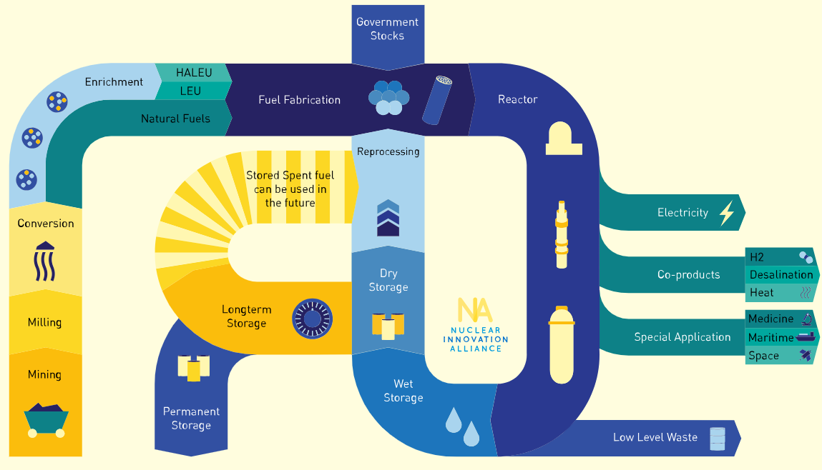
The Fuel Cycle
Notes:
The diagram shows that the fuel cycle starts well before the reactor and continues long after operation.
On the front end, fuel has to be mined, milled, converted, enriched if required and fabricated into the form needed by the reactor.
For advanced systems, the diagram also highlights HALEU, government stocks and reprocessing as possible parts of the supply route.
Inside the reactor, fuel produces the heat that becomes electricity, heat, hydrogen, desalination, maritime power or other special applications.
After discharge, used fuel may go through wet storage, dry storage, reprocessing, long-term storage or permanent disposal depending on policy and technology.
For maritime use, every step has to be planned: transport packages, safeguards, security, storage, refuelling location and end-of-life responsibility.
This is why fuel cycle is not a back-end administrative topic. It is part of the operating model.

Slide 30
Fuel & Strategy
Fuel choice | Typical enrichment / form | Strategic effect
LEU oxide fuel | Up to 5% U-235; pellets in metal cladding | Most mature supply chain; shorter cycles or larger cores for compact maritime plants
HALEU fuel | Above 5% and below 20% U-235; oxide, metal or TRISO variants | Enables longer cycles and compact cores, but supply chain and safeguards burden increase
TRISO fuel | Coated fuel particles embedded in graphite or compact forms | High-temperature tolerance and strong fission-product retention; fabrication less mature
Liquid fuel | Fuel dissolved in circulating molten salt | Potential online processing and flexible fuel management; chemistry and licensing uncertainty remain
Metal / alloy fuel | Often fast-spectrum fuel form | High heavy-metal density and compact cores; fabrication, irradiation data and coolant compatibility matter
Notes:
This table is the fuel equivalent of the reactor comparison section.
LEU oxide fuel is the mature baseline. It has the strongest commercial supply chain and the most operating experience, but compact maritime reactors may need larger cores or shorter cycles if they are constrained to conventional LEU.
HALEU is uranium enriched above 5 percent and below 20 percent U-235. It can support more compact cores, longer cycles and better fuel utilisation, but the supply chain, safeguards and transport burden increase.
TRISO is a fuel form rather than only an enrichment choice. Its value comes from coated particles that provide strong fission-product retention and high-temperature tolerance.
Liquid fuel, such as fuel dissolved in molten salt, changes the plant architecture because the fuel is part of the circulating system. That can create fuel-management flexibility, but it also creates chemistry, off-gas, accountancy and licensing challenges.
Metal and alloy fuels can provide high heavy-metal density and are often relevant to fast-spectrum systems, but fabrication qualification, irradiation performance and coolant compatibility are central.

Slide 31
Fuel choices shape the whole operating model
Area affected | What changes when fuel changes
Supply chain | Enrichment level, fabrication route, qualified vendors, transport packaging and lead time
Safeguards and security | Material attractiveness, accountancy frequency, surveillance, physical protection and port-state confidence
Operational planning | Cycle length, refueling location, outage duration, spare-core strategy and crew competence
Lifecycle management | Spent fuel cooling, storage, transport, reprocessing option, waste form and decommissioning scope
Commercial model | Availability guarantees, insurance case, offtake contracts, route flexibility and residual liability allocation
Notes:
This is one of the most important slides in the presentation because it connects fuel to actual deployability from a commercial standpoint.
When the fuel changes, the supply chain changes: enrichment level, fabrication route, qualified vendors, transport packaging and procurement lead time all change.
Safeguards and security also change because material attractiveness, accountancy frequency, surveillance and physical protection requirements depend on the material and the route.
Operational planning changes because fuel determines cycle length, refuelling location, outage duration, spare-core strategy and the training required for operators and maintenance teams.
Lifecycle management changes because spent fuel cooling, storage, transport, reprocessing options, waste form and decommissioning scope all depend on the fuel and reactor combination.
The commercial model changes too, because availability guarantees, insurance cases, offtake contracts, route flexibility and liability allocation depend on the refuelling and lifecycle plan.

Slide 32
Commercial maturity versus uncertainty
Technology / fuel route | Commercial maturity | Industrial and regulatory uncertainty
PWR / LWR with LEU oxide | High | Marine licensing, vessel integration, emergency planning and port-state acceptance
HTGR with TRISO | Medium | TRISO scale-up, graphite management, maritime plant size and licensing precedent
Fast reactor with metal / oxide fuel | Low to medium | Coolant-specific safety case, fuel qualification and limited operating base
Molten salt with liquid fuel | Low | Fuel salt chemistry, materials, off-gas, tritium, safeguards and waste form
HALEU supply chain | Emerging | Availability, enrichment capacity, fabrication qualification, transport and security classification
Notes:
This slide helps avoid overclaiming because it separates technical attractiveness from commercial maturity.
PWR and LWR technology with LEU oxide fuel is the mature baseline, but maritime licensing, vessel integration, emergency planning and port-state acceptance are still non-trivial.
HTGRs with TRISO have a strong safety story and high-temperature potential, but TRISO scale-up, graphite management, plant size and maritime licensing precedent still matter.
Fast reactors with metal or oxide fuel may offer compact cores and better fuel utilisation, but coolant-specific safety cases, fuel qualification and limited operating experience remain key uncertainties.
Molten salt systems with liquid fuel may offer low pressure and fuel-management flexibility, but salt chemistry, materials, off-gas, tritium, safeguards and waste form need strong evidence.
The HALEU supply chain is emerging rather than fully mature, and that affects availability, enrichment capacity, fabrication qualification, transport and security classification.
The practical message is that mature technology is not automatically maritime-ready, and advanced technology is not automatically commercially ready.

Slide 33
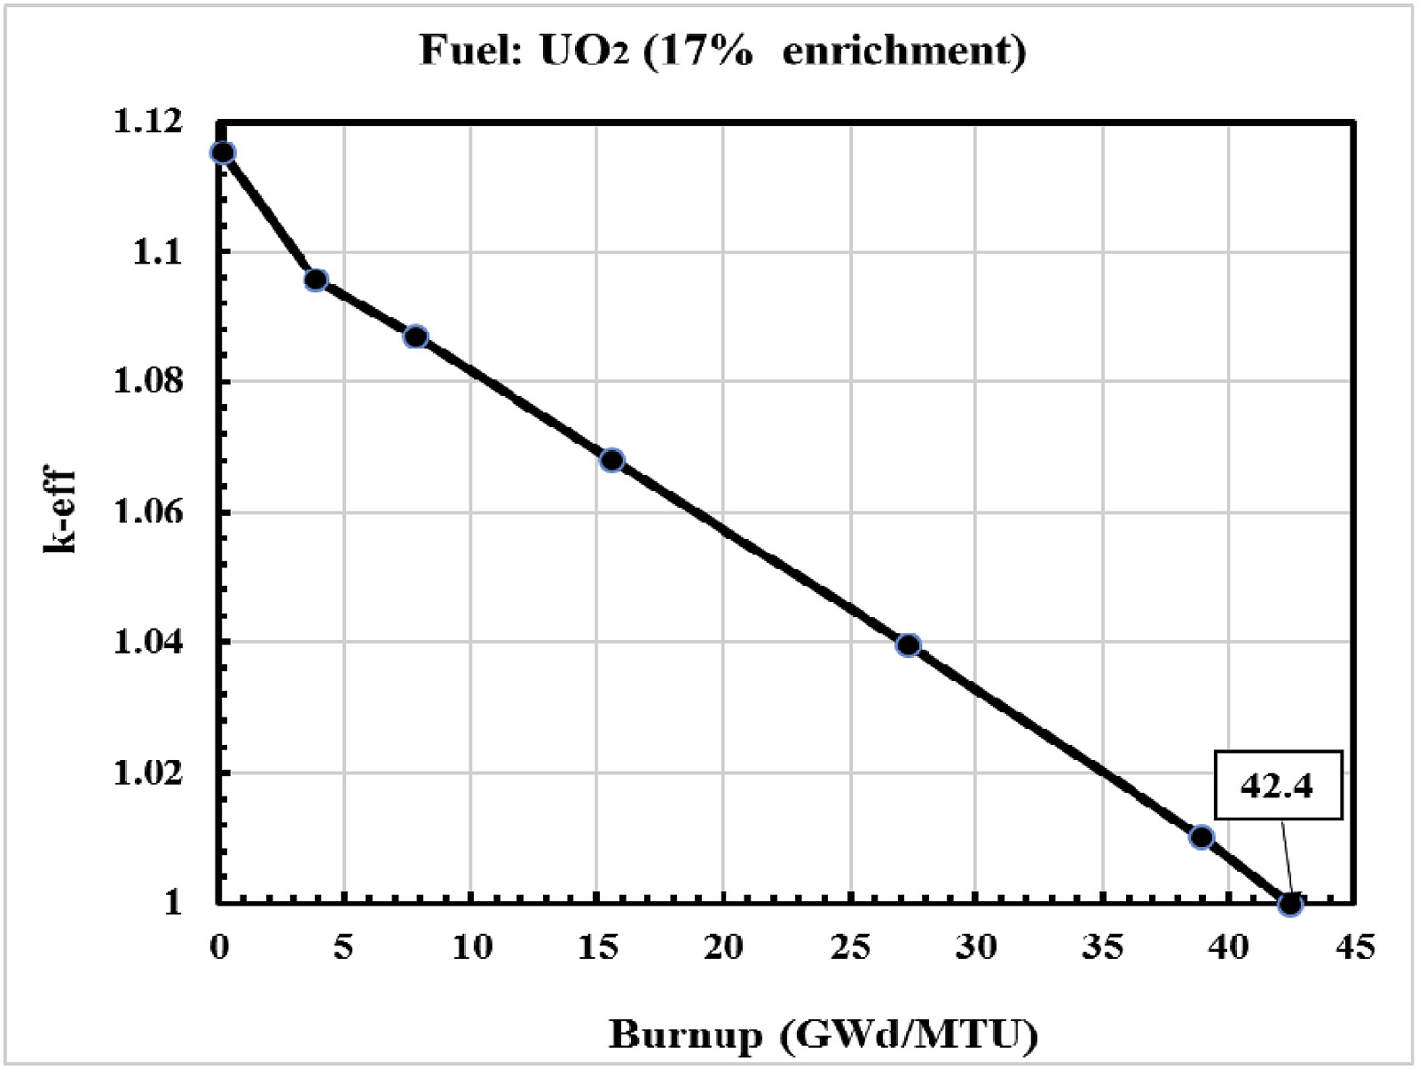
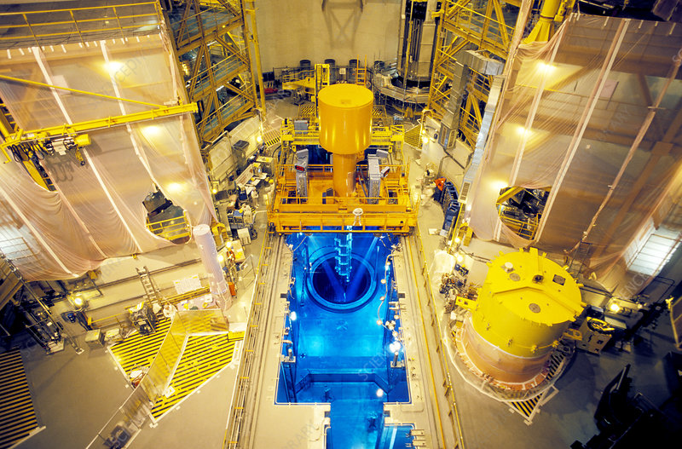
When does a Reactor refuel?
As the fissile material decreases, reactors require some of the used fuel to be replaced with fresh fuel to maintain the chain reaction
In Light Water Reactors, about a third of the fuel is replaced every ~18 months – requiring reactor shutdown for a few weeks.
Refueling frequency and method depends on reactor design, initial fuel loading and capacity factor. For example CANDU reactors refuel online and more frequently.
k-eff vs Burnup
Photo of Reactor Fueling Process
Notes:
Let’s talk about refuelling.
As fissile material is consumed and neutron-absorbing fission products build up, the reactor gradually loses reactivity margin.
Refuelling restores that margin by replacing some used fuel with fresh fuel, or by changing the fuel configuration depending on the reactor design.
In many light-water reactors, roughly one third of the core is replaced during a refuelling outage about every 18 months, although the exact cycle is design-specific.
The k-effective curve is a useful way to show that the core must remain critical during operation while retaining enough shutdown and control margin.
For maritime nuclear, refuelling is more than a technical outage. It is a port operation, a security operation, a safeguards operation and a commercial availability event.
It is expected that an FNPP or propelled ship will return to a nuclear service yard where it can be refuelled.
That is why long-cycle designs are attractive, but the cost is usually higher initial fissile loading.

Slide 34
Responsible nuclear waste management
Process | Method
Prevention/ Minimization: | Reducing the amount of waste produced in the first place.
Reuse: | Finding new applications for materials where possible.
Recycling: | Processing waste to recover usable materials.
Treatment and Conditioning: | Making the waste safer and more compact.
Disposal: | The final step, which is used only when other options are not feasible.
Nuclear waste management is the process of treating, conditioning, and disposing of radioactive waste in a safe and secure manner.
It involves activities such as characterization, waste minimization, volume reduction (e.g., compaction, vitrification), packaging, and long-term storage or deep geological disposal for high-level radioactive waste.
The process relies on the waste hierarchy, which prioritizes reduction, reuse, and recycling, and involves stringent safety cases and monitoring to protect human health and the environment.
The nuclear waste hierarchy
Notes:
Let’s now talk about closing out the lifecycle loop.
Nuclear waste management is the controlled process of characterising, reducing, treating, conditioning, storing and disposing of radioactive waste.
The waste hierarchy is useful because it starts with prevention and minimisation before moving to reuse, recycling, treatment, conditioning and disposal.
For spent fuel, the first practical requirement is cooling and shielding, because decay heat and radiation remain after discharge.
Depending on national policy and reactor technology, used fuel may be stored, reprocessed, recycled into new fuel or sent toward final disposal.
For maritime nuclear, the end-of-life plan must be credible before deployment because port states, insurers, customers and regulators will all ask what happens to the fuel after operation.
This reinforces the presentation message: the reactor, fuel and lifecycle route must be integrated into one strategy.

Slide 35
Notes:
To close, there is no universally best maritime reactor.
Floating nuclear power and propulsion optimise for different outcomes, so they may need different reactor and fuel strategies.
Proven reactors offer maturity and clearer licensing routes, while advanced reactors may offer better long-term technical fit if industrial and regulatory uncertainty is resolved.
Fuel choice determines much more than the core. It shapes supply chain, safeguards, refuelling, operations, waste and commercial risk.
Thank you for your time, and I hope you enjoy Robert’s presentation, and the rest of your day.

